Slide 1
Fourier Optics
P47 – Optics: Unit 8

Slide 2
Unit 8
Course Outline
Unit 1: Electromagnetic Waves
Unit 2: Interaction with Matter
Unit 3: Geometric Optics
Unit 4: Superposition of Waves
Unit 5: Polarization
Unit 6: Interference
Unit 7: Diffraction
Unit 8: Fourier Optics
Unit 9: Modern Optics

Slide 3
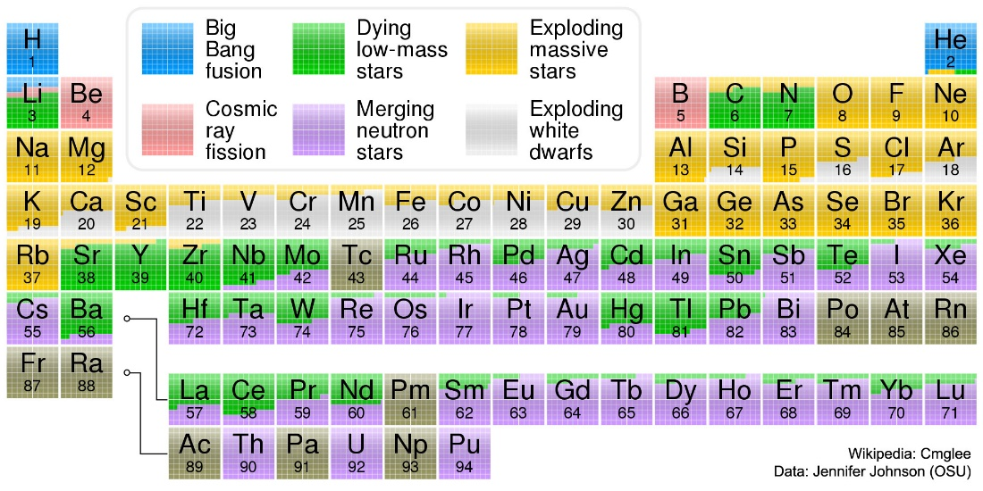
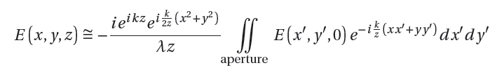
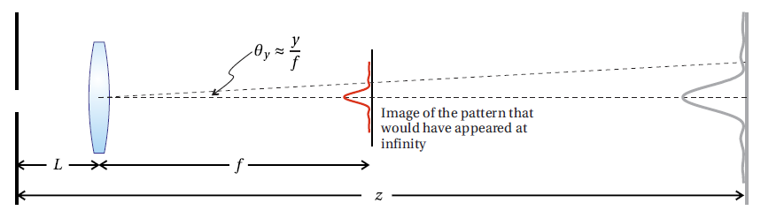
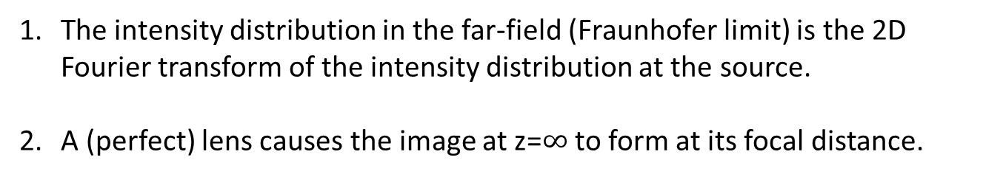
Unit 8
Fourier Optics: The Basic Idea
The intensity distribution in the far-field (Fraunhofer limit) is the 2D Fourier transform of the intensity distribution at the source.
A (perfect) lens causes the image at z=$∞$ to form at its focal distance.
Peatross & Ware

Slide 4
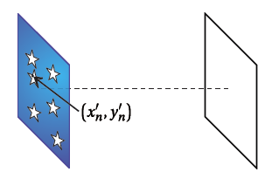
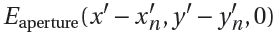
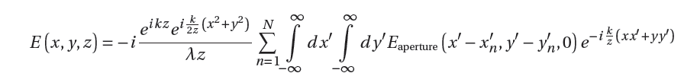
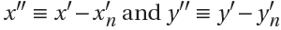
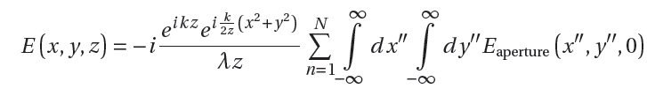
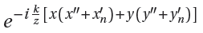
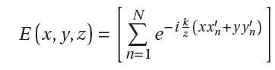
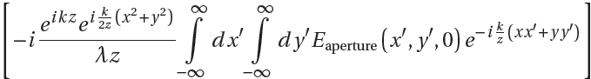
Unit 8
Array Theorem
Calculate the diffraction pattern caused by N identical apertures with
Each aperture has a location $\left(x_{n}^{′}, { y}_{n}^{′}\right)$, so that we use
Change of variables:

Slide 5
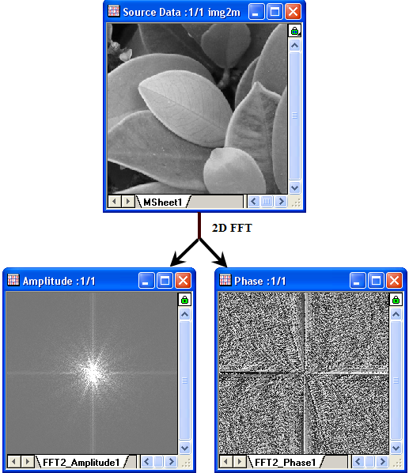
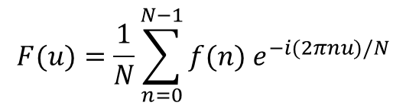
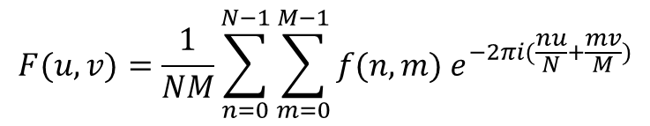
Unit 8
Array Theorem in the Real World:
Discrete Fourier Transform of 2D Images
For a list of N sample data points (1D)
$$F(u)=\frac{1}{N}\sum_{n=0}^{N−1}{f(n) e^{−i(2πnu)/N}}$$
For an MxN array of sample data points (2D)
$$F(u,v)=\frac{1}{NM}\sum_{n=0}^{N−1}{\sum_{m=0}^{M−1}{f(n,m) e^{−2πi(\frac{nu}{N}+\frac{mv}{M})}}}$$
A lot of work has been put into algorithms to
calculate this as efficiently as possible. (FFTW)
www.originlab.com

Slide 6
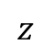
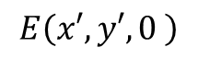
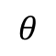
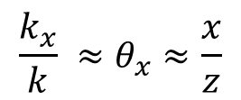
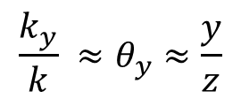
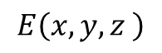
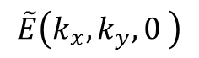
Unit 8
Fourier Optics
Connection between the spatial frequency at a source, and the intensity in the far-field
$$E\left(x,y,z \right)$$
$$E\left(x′,y′,0 \right)$$
$$θ$$
$$\tilde{E}\left(k_{x},k_{y},0 \right)$$
$$z$$
$$\frac{k_{x}}{k} ≈θ_{x}≈\frac{x}{z}$$
$$\frac{k_{y}}{k} ≈θ_{y}≈\frac{y}{z}$$

Slide 7
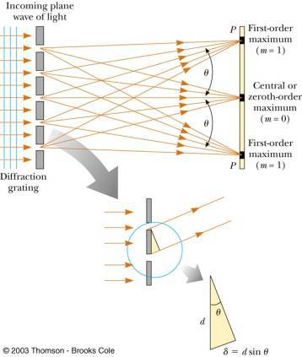
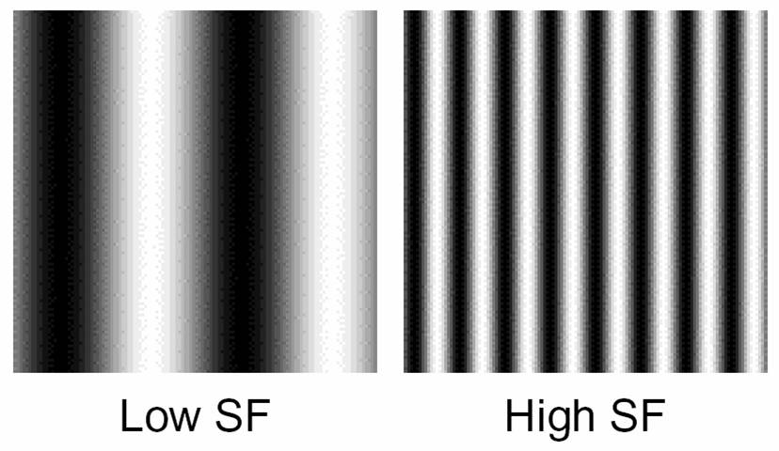
Unit 8
Spatial Frequency
Spatial information in images can be broken down into Fourier components, at high and low frequency
units of 1/length (e.g. cycles/mm)

Slide 8
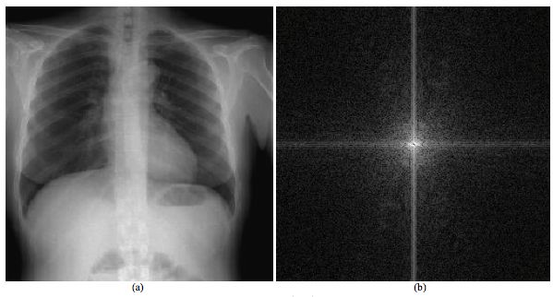
Unit 8
Spatial Frequency
k_{y}
k_{x}
Low spatial frequency information is at the center of the Fourier plane
high spatial frequency information is at the edges

Slide 9
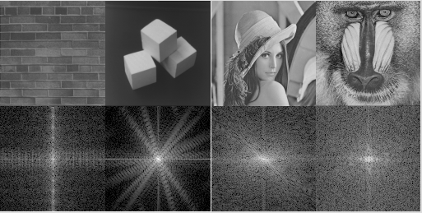
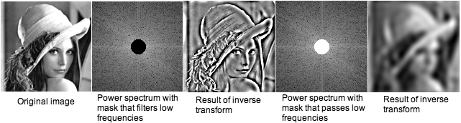
Unit 8
Fourier Filter Image Processing

Slide 10
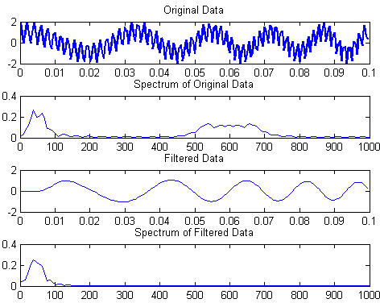
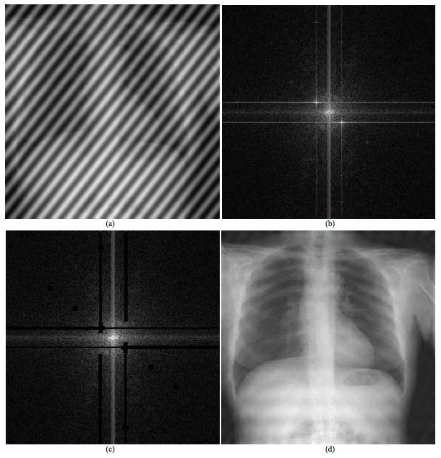
Unit 8
Fourier Filter Image Processing
can filter out unwanted noise if it’s sufficiently distinct in spatial frequency from the signal of interest
Block out spatial frequencies associated with the diagonal lines to recover most of the information in the original image
These techniques are pretty important in medical imaging of all kinds

Slide 11
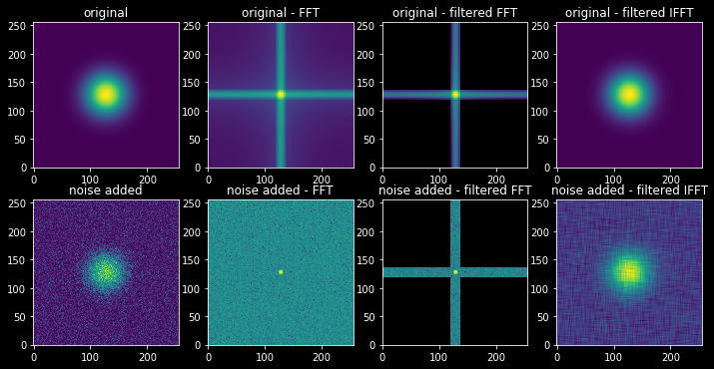
Unit 8
Fourier Filter Image Processing

Slide 12
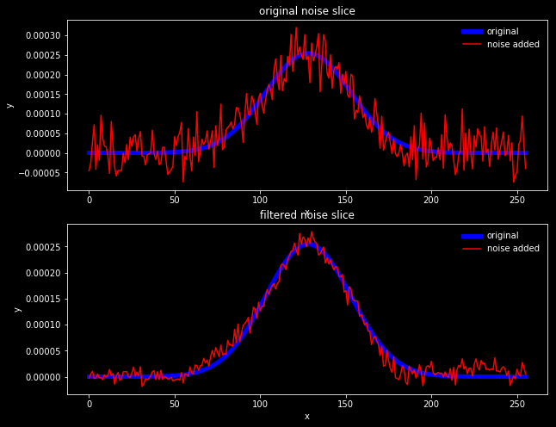
Unit 8
Fourier Filter Image Processing

Slide 13
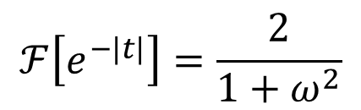
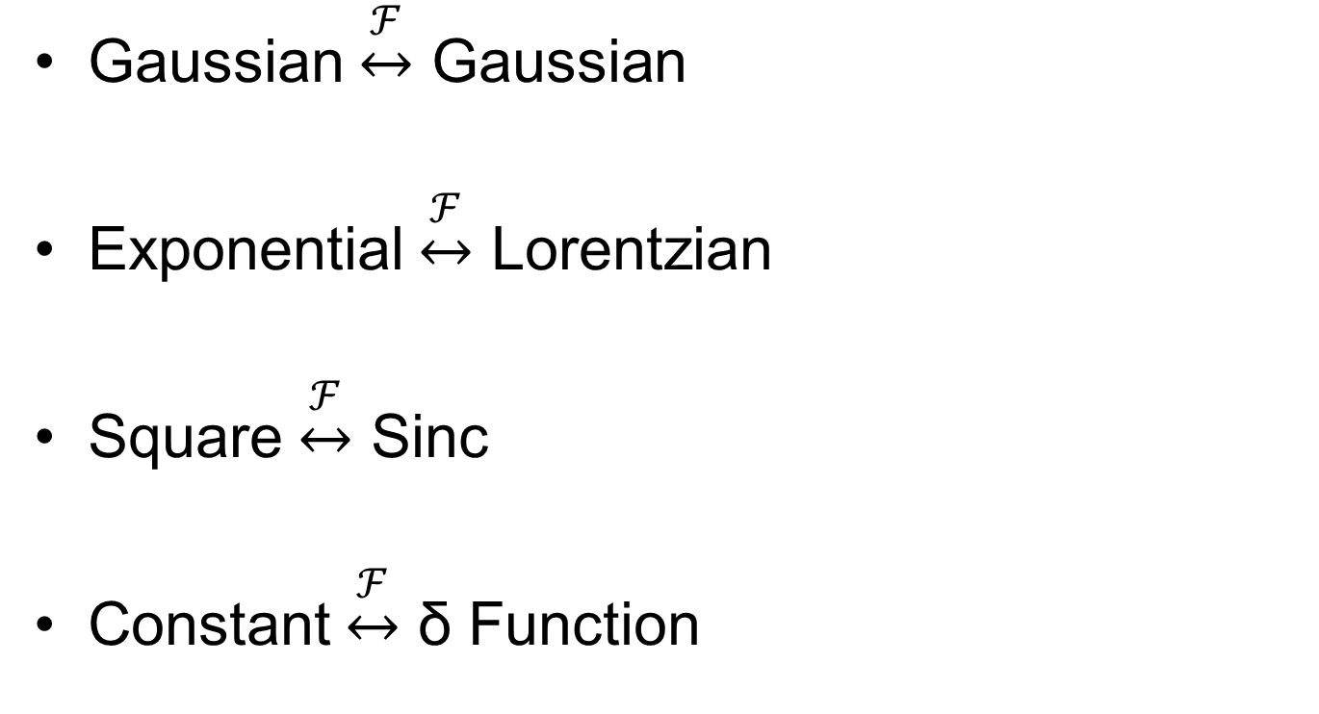
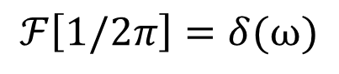
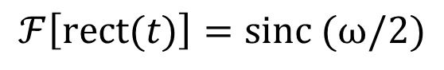
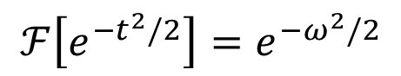
Unit 8
Common Fourier Transforms
Gaussian $\underset{↔}{ℱ}$ Gaussian
Exponential $\underset{↔}{ℱ}$ Lorentzian
Square $\underset{↔}{ℱ}$ Sinc
Constant $\underset{↔}{ℱ}$ δ Function
$$ℱ\left[e^{−t^{2}/2}\right]=e^{−ω^{2}/2}$$
$$ℱ\left[e^{−|t|}\right]=\frac{2}{1+ω^{2}}$$
$$ℱ\left[\operatorname{rect}{(t)}\right]=sinc (ω/2)$$
$$ℱ\left[1/2π\right]=δ(ω)$$

Slide 14
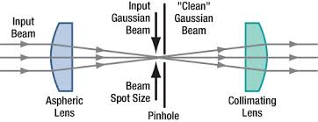
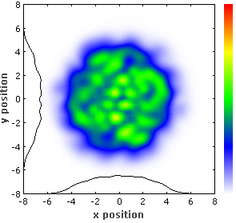
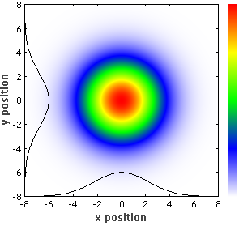
Unit 8
Spatial Filtering of a Laser
Removing high spatial frequency components from the Fourier/focal plane results in a smoother laser beam, without speckle and distortion
Input beam
Output beam

Slide 15
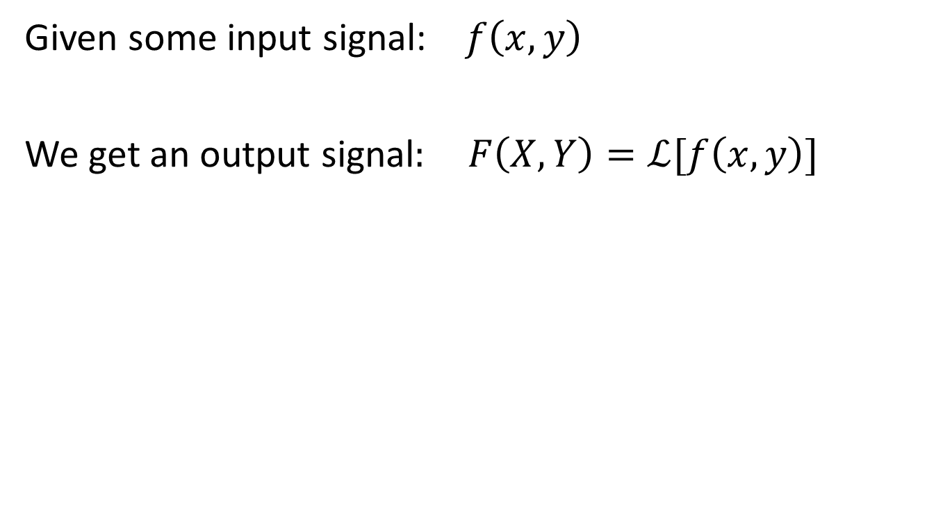
Unit 8
Linear Systems
Given some input signal: $f\left(x,y\right)$
We get an output signal$: F\left(X,Y\right)=ℒ[f\left(x,y\right)]$

Slide 16
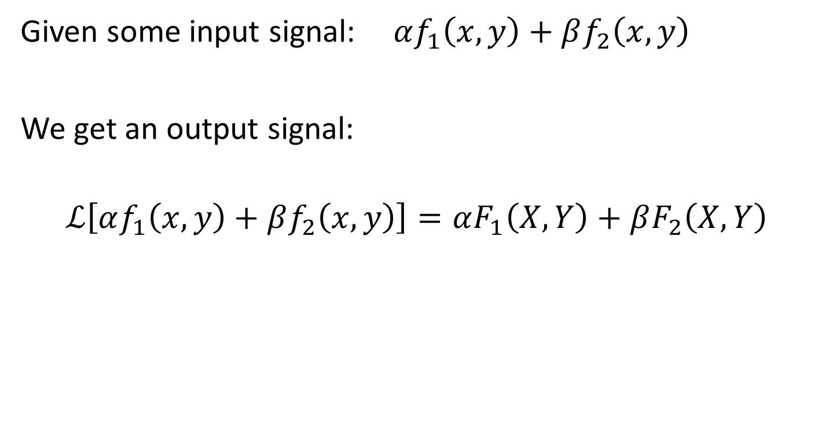
Unit 8
Linear Systems
Given some input signal:$αf_{1}\left(x,y\right)+βf_{2}\left(x,y\right)$
We get an output signal:
$$ℒ\left[αf_{1}\left(x,y\right)+βf_{2}\left(x,y\right)\right]=αF_{1}\left(X,Y\right)+βF_{2}\left(X,Y\right)$$

Slide 17
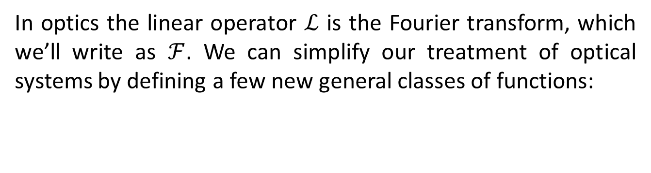
Unit 8
Linear Systems
In optics the linear operator $ℒ$ is the Fourier transform, which we’ll write as $ℱ$. We can simplify our treatment of optical systems by defining a few new general classes of functions:
Aperture Function
Point Spread Function
Transfer Function
These general ideas apply to a much wider variety of physical systems: e.g. linear electronic circuits

Slide 18
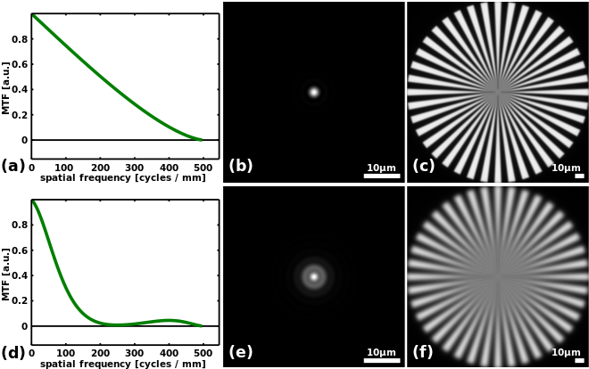
Unit 8
What’s the Point?
We need better tools than the Rayleigh resolution criterion for determining how faithfully our optical systems transmit information from source to image:
Modulation Transfer Function

Slide 19
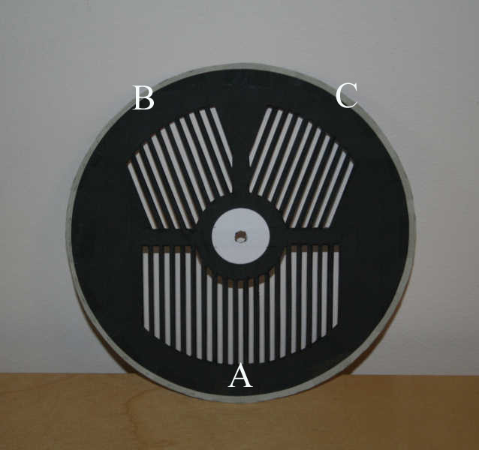
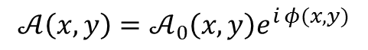
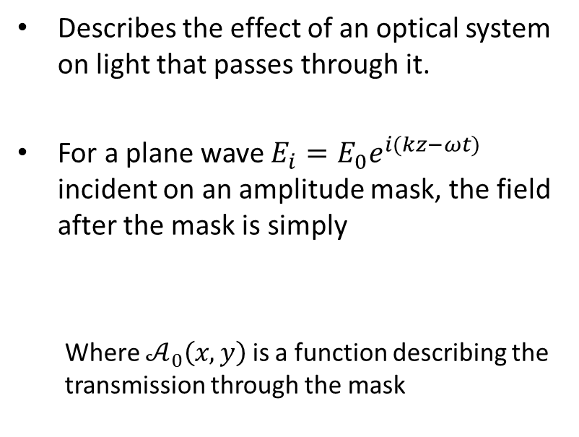
Unit 8
Aperture (pupil) Function
$$𝒜\left(x,y\right)=𝒜_{0}\left(x,y\right)e^{i φ(x,y)}$$
Describes the effect of an optical system on light that passes through it.
For a plane wave $E_{i}=E_{0}e^{i(kz−ωt)}$ incident on an amplitude mask, the field after the mask is simply
Where $𝒜_{0}\left(x,y\right)$ is a function describing the transmission through the mask
Bahtinov mask (geoastro.com)
$$E_{𝒜}\left(x,y\right)=E_{0}𝒜_{0}\left(x,y\right)e^{i φ(x,y)}=E_{0}𝒜_{0}\left(x,y\right)$$

Slide 20
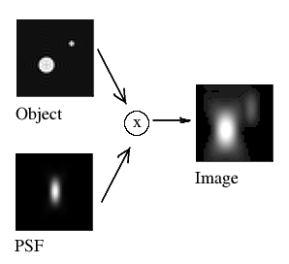
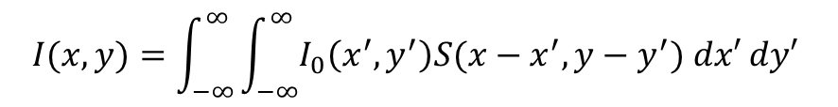
Unit 8
Point Spread Function imaging in the “real world”
What if we don’t have a point object?
The image formed by a real, finite imaging system is the convolution of the ideal image with the point spread function.
$$I(x,y)=\int_{−∞}^{∞}{\int_{−∞}^{∞}{I_{0}\left(x^{′},y^{′}\right)S(x−x^{′},y−y^{′}}}) dx′ dy′$$
Practically speaking, the ideal image gets blurred out in a very specific way determined by the point spread function

Slide 21
Unit 8
Array Theorem
Calculate the diffraction pattern caused by N identical apertures with
Each aperture has a location $\left(x_{n}^{′}, { y}_{n}^{′}\right)$, so that we use
Change of variables:

Slide 22
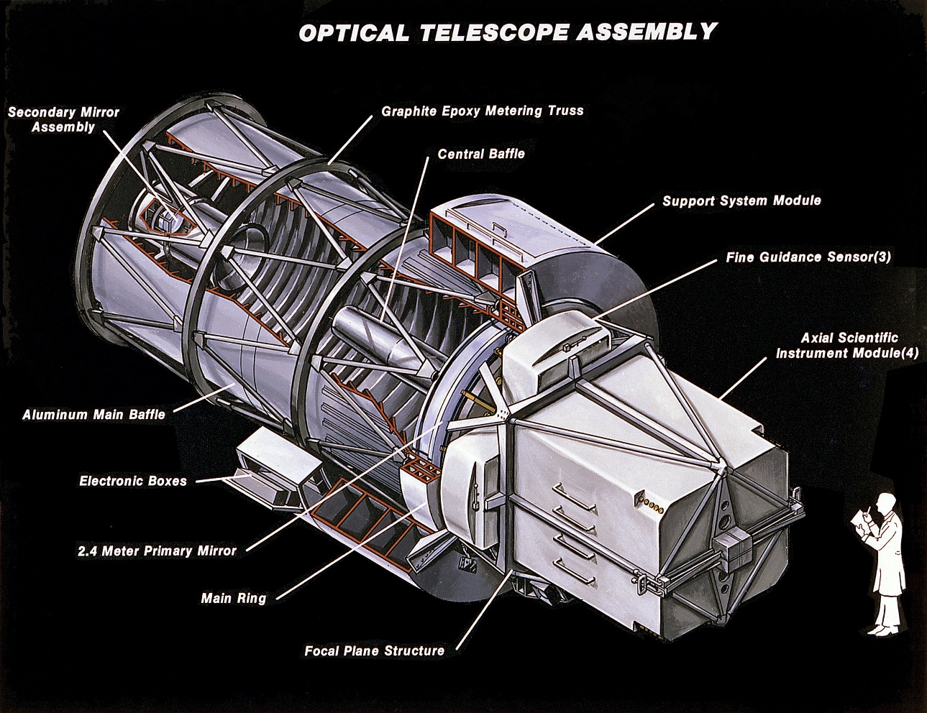
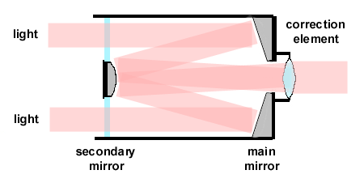

Unit 8
Example: Annular Aperture
It hurts the resolution a bit, but how much?
Autocorrelation of an annular aperture: HW!

Slide 23

Unit 8
Example: Annular Aperture
$$𝒜\left(ρ\right)=\left\{\begin{matrix} 1 εa<ρ<a; \\ 0 elsewhere\end{matrix}\right.$$
a

Slide 24







Unit 8
Example: PSF of Annular Aperture
$$𝒫=ℱ{\left[𝒜_{0}\right]}^{2}$$
$$𝒜_{ε}\left(ρ\right)=\left\{\begin{matrix} 1 εa<ρ<a; \\ 0 elsewhere\end{matrix}\right.$$
What is the Fourier transform of this function?
Start with the (known) Fourier transform of a circular aperture of radius $a (ε=0)$
$$ℱ\left[𝒜_{ε=0}\right]={2πa}^{2}\frac{J_{1}\left(aρ\right)}{aρ}$$
Subtract off the Fourier transform of circle of radius $εa$(Babinet’s principle!)
$$ℱ\left[𝒜_{ε}\right]=2πa^{2}\left(\frac{J_{1}\left(aρ\right)}{aρ}\right)−2π{ε^{2}a}^{2}\left(\frac{J_{1}\left(εaρ\right)}{εaρ}\right)$$
$$=2πa^{2}\left[\left(\frac{J_{1}\left(ka\right)}{ka}\right)−ε^{2}\left(\frac{J_{1}\left(εaρ\right)}{εaρ}\right)\right]$$

Slide 25






Unit 8
Example: PSF of Annular Aperture
To get the point spread function:
$$𝒫= ℱ{\left[𝒜_{ε}\right]}^{2} ={\left(2πa^{2}\right)}^{2}{\left[\left(\frac{J_{1}\left(aρ\right)}{aρ}\right)−ε^{2}\left(\frac{J_{1}\left(εaρ\right)}{εaρ}\right)\right]}^{2}$$
What’s the point of this?
This is the intensity pattern you’ll see from a point source:
$$I\left(ρ\right)=I_{ε=0}\left(0\right) {\left(2πa^{2}\right)}^{2}{\left[\left(\frac{J_{1}\left(aρ\right)}{aρ}\right)−ε^{2}\left(\frac{J_{1}\left(εaρ\right)}{εaρ}\right)\right]}^{2}$$
$$ε=0$$
$$ε=0.25$$
$$ε=0.5$$

Slide 26




Unit 8
Example: PSF of Annular Aperture
Note: Don’t leave out the cross terms!
$$𝒫={\left[\left(\frac{J_{1}\left(ka\right)}{ka}\right)−ε^{2}\left(\frac{J_{1}\left(kεa\right)}{kεa}\right)\right]}^{2}$$
$$≠ \left[{\left(\frac{J_{1}\left(ka\right)}{ka}\right)}^{2}−ε^{2}{\left(\frac{J_{1}\left(kεa\right)}{kεa}\right)}^{2}\right]$$
No central obstruction
wrong expression: $ε=0.5$
correct expression: $ε=0.5$
Notice the “wrong” solution is also obviously unphysical!

Slide 27






Unit 8
Example: The Hubble PSF Calculation
$$r_{p}=1.104 m$$
$$r_{s}=0.135 m$$
($ε=0.122$ )
Single Wavelength
$$λ=632 nm$$
$$λ=500−700 nm$$

Slide 28



Unit 8
Example: The Hubble PSF Calculation
Point-source diffraction pattern
There’s spatial frequency information hiding
in plain sight here
Hubble aperture model:
Secondary mirror obstruction
Radial supports for secondary
Three pads holding primary mirror
$$\underset{↔}{ℱ}$$

Slide 29




Unit 8
Convolution, Correlation, and Autocorrelation
The convolution of two one-dimensional functions is:
$$f⊛g=\int_{−∞}^{∞}{f\left(x^{′}\right)g(x−x^{′}}) dx′$$
The (cross) correlation of two functions is
$$f⊙g=\int_{−∞}^{∞}{f^{∗}\left(x^{′}\right)g(x+x^{′}}) dx′$$
Note that if either function is even
$$f⊛g=f⊙g$$
Correlation of a function with itself is called an autocorrelation
$$f⊙f=\int_{−∞}^{∞}{f\left(x^{′}\right)f(x+x^{′}}) dx′$$

Slide 30



Unit 8
Convolution
$$f⊛g=\int_{−∞}^{∞}{f\left(x^{′}\right)g(x−x^{′}}) dx′$$
https://en.wikipedia.org/wiki/Convolution

Slide 31




Unit 8
Convolution Examples

Slide 32


Unit 8
Convolution Theorem
$$ℱ\left[f∗g\right]=ℱ\left[f\right] ℱ[g]$$
(proof in notes)
Why is this useful?
To convolve two functions, Fourier transform them, multiply them together
and then apply the inverse Fourier transform on their product!
$$f∗g=ℱ^{−1} [ ℱ\left[f\right] ℱ\left[g\right] ]$$
If you already know the Fourier (and inverse) transforms
it makes calculating the convolution much easier!

Slide 33











Unit 8
Convolution Theorem
$$f$$
$$⊛$$
$$h$$
$$=$$
$$f⊛h$$
$$ℱ\left[f\right]$$
$$×$$
$$ℱ[h]$$
$$=$$
$$ℱ\left[f∗h\right]$$

Slide 34








Unit 8
Example: Convolution of two Gaussians
$$f\left(x\right)=Ae^{−x^{2}/α^{2}}$$
$$g\left(x\right)=Be^{−x^{2}/β^{2}}$$
$$f∗g=?$$
$$ℱ\left[f\right]=Aα\sqrt{π}e^{−α^{2}k^{2}/4}$$
$$ℱ\left[g\right]=Bβ\sqrt{π}e^{−β^{2}k^{2}/4}$$
$$ℱ\left[f\right] ℱ\left[g\right]=ABαβπe^{−\left(α^{2}+β^{2}\right)k^{2}/4}$$
$$=ABαβ\sqrt{π}e^{−\frac{x^{2}}{\left(α^{2}+β^{2}\right)}}$$
$$f∗g=ℱ^{−1}[ℱ\left[f\right] ℱ\left[g\right]]$$
The convolution is still a Gaussian and the width
is that of the original Gaussians summed in quadrature!

Slide 35



Unit 8
Evaluating Fidelity of Optical Systems
Remember this is a linear system:
$$g\left(X,Y\right)=ℒ[f\left(x,y\right)]$$
If we put in a signal at a specific spatial frequency, we can ask how well that information is reproduced at the output of the system (the final image)
The Modulation Transfer Function (MTF) measures loss of contrast for sharp lines at different spatial frequencies
Modulation $= \frac{I_{max}−I_{min}}{I_{max}+I_{min}}$
Full
contrast
No
contrast

Slide 36







Unit 8
Calculating the Modulation Transfer Function
MTF is simply the autocorrelation of the aperture function of the system!
$$ℳ=𝒜⨀𝒜$$
Aperture function:
$$𝒜_{0}=rect{(x/D)}$$
Rescale to spatial-frequency units:
$$k=\frac{x}{λf}$$
The autocorrelation of a rectangle is easy: it’s just a triangle…
$$MTF\left(k\right)=1−\frac{k}{k_{c}}$$
Note: The cutoff frequency above which no spatial information makes it through the system (diffraction limit!)
$$k_{c}=\frac{λD}{f}$$

Slide 37



Unit 8
Modulation Transfer Function (Square vs Circular Aperture)
The cutoff frequency is the same for square and circular apertures
BUT the frequency/wavelength dependence is different
(less light = less resolving power!)
Low spatial frequencies make it through fine
Higher spatial frequencies have less
contrast, falling to zero at the cutoff
$$k_{c}=\frac{λD}{f}$$
The larger the aperture, the higher the cutoff frequency (more resolution)

Slide 38


Unit 8
Measuring Modulation Transfer Function
MTF for real optical elements is normally measured
most common to simply image a target object of various spatial frequencies
takes aberrations into account

Slide 39




Unit 8
Evaluating MTF and Resolution
Are many different test patterns…

Slide 40


Unit 8
Real-World Diffraction Limit
$$k_{c}=\frac{λD}{f}$$
Reality: Aperture usually isn’t the limiting factor,
it’s aberrations (esp. atmospheric conditions)
Subaru Telescope (D = 8 m)
Hubble (D = 2.4 m)

Slide 41
Unit 8
Fourier Optics

